Slide 1


CIS 404 Capstone Project
Jerry Mai

Slide 2
CONTENTS
01
SDLC
02
Jira Usage
03
Design Algorithm
04
Product Showcase
05
Thank You

Slide 3
Clearly outline the goals and objectives of the Brick Break game
Planning
S
D
L
C
Identify functional and non-functional requirements for the game.
Analysis
Define the overall architecture of the game, including class diagrams and interaction flows
Design
Platform, Ball, Score and Graphics
Implementation
Run the game to see if it runs to requirement and fix any bugs identified
Testing & Integration
Notes:
No maintenance because game is up to date at the moment.

Slide 4

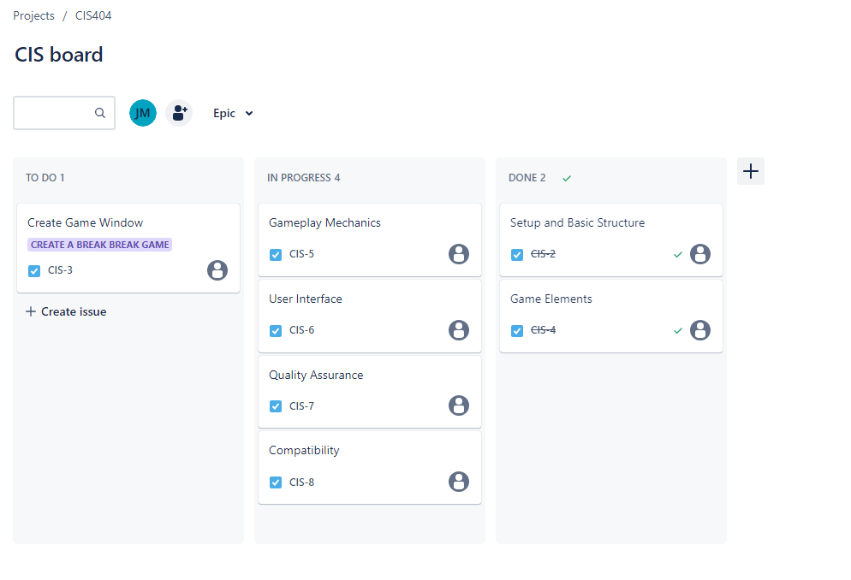
Jira Usage
Main goal is Jira is to set up a project and delegate tasks or issue to your team. In this project, I used it to help plan what to do next and keep track of my current and finished progress.

Slide 5

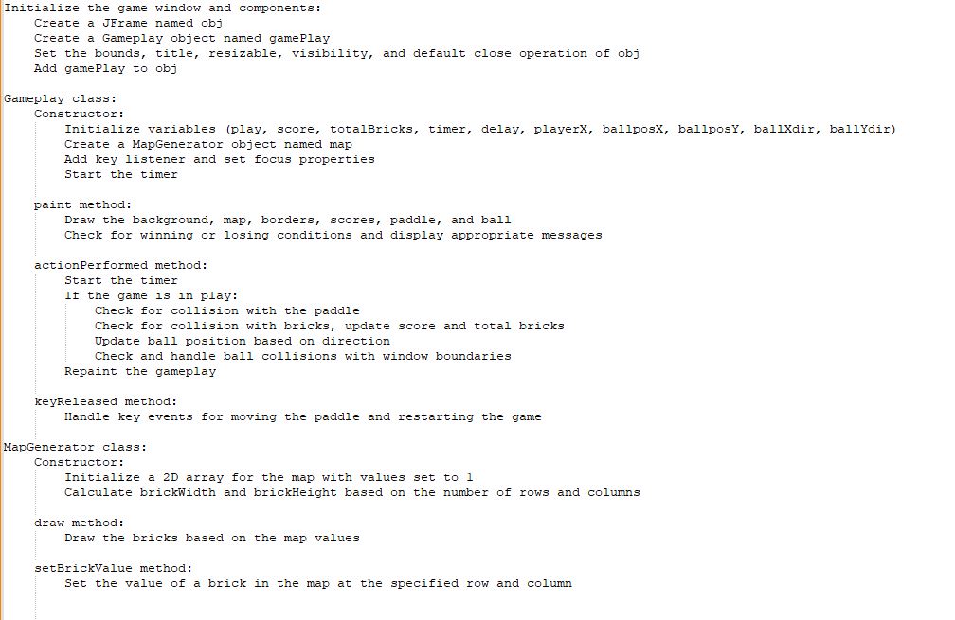

Design Algorithm

Slide 6

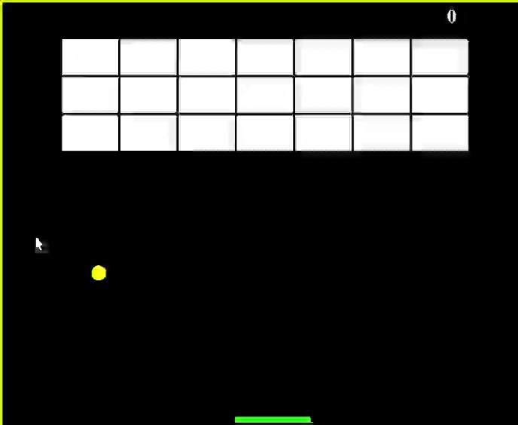
Product Showcase

Slide 7



Jerry Mai
Jmai@nyc.yearup.org
LinkedIn
GitHub
THANK YOU!

